Slide 1


COVID19 ASSISTANT HELP

Slide 2
DATA PIRATES TEAM
Kanikaram varunteja
Praveen kumar
PROJECT NAME
Covid-19 ChatBot using IBM Watson ASSITANCE
TEAM NAME
MLRITM- Binary Beasts

Slide 3
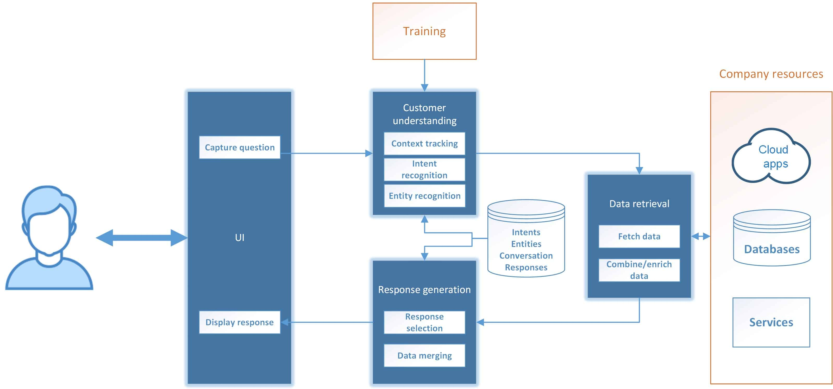
CHATBOT ARCHITECTURE

Slide 4
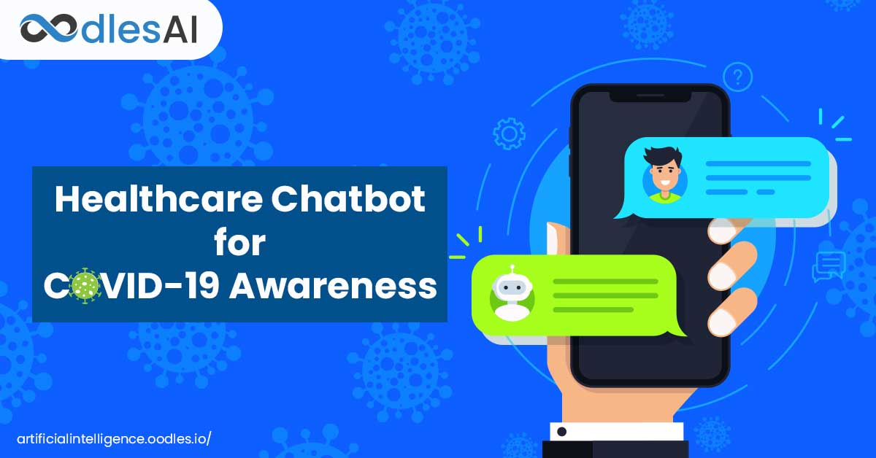
CHARTBOT ASSISTANT AWareness

Slide 5
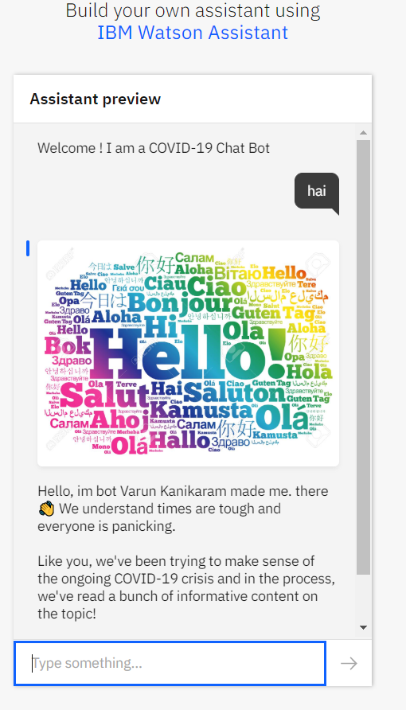
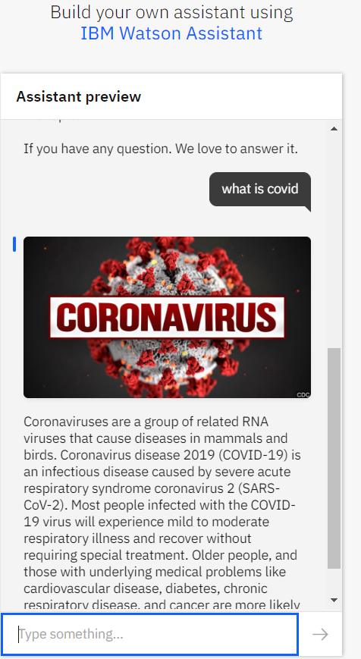
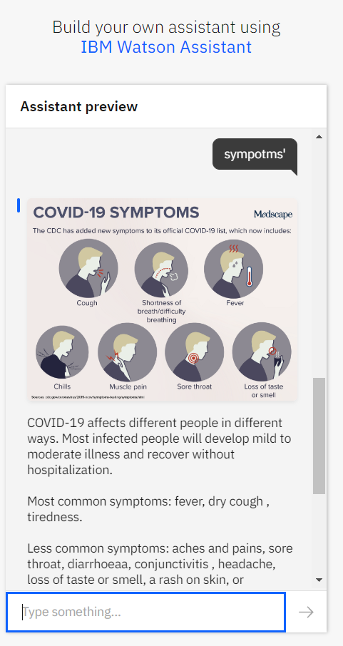

Slide 6
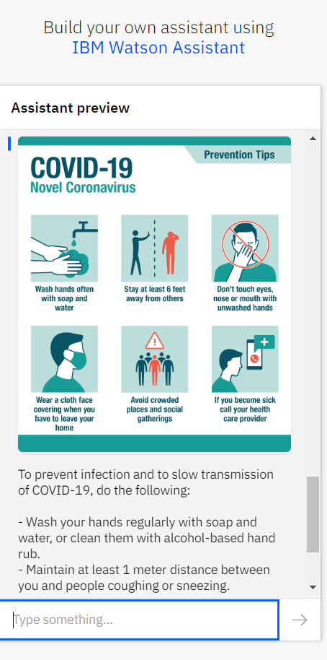
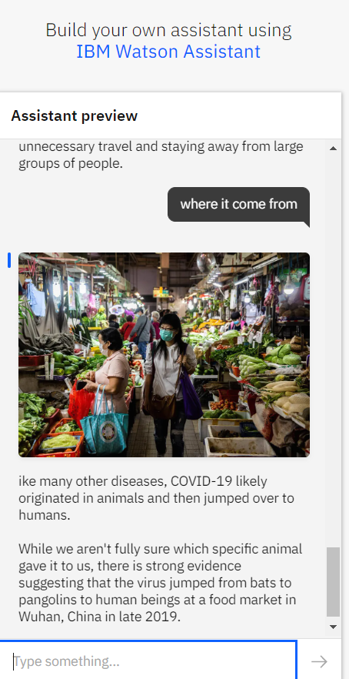
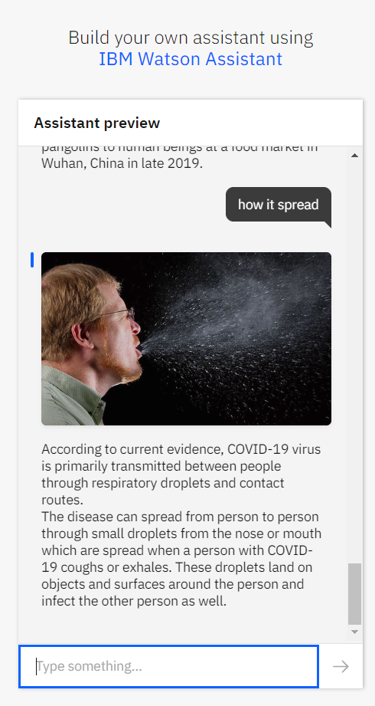

Slide 7
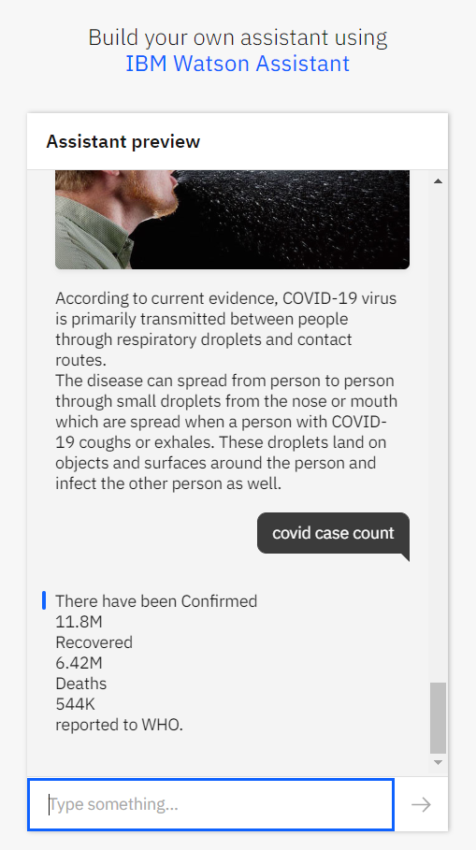
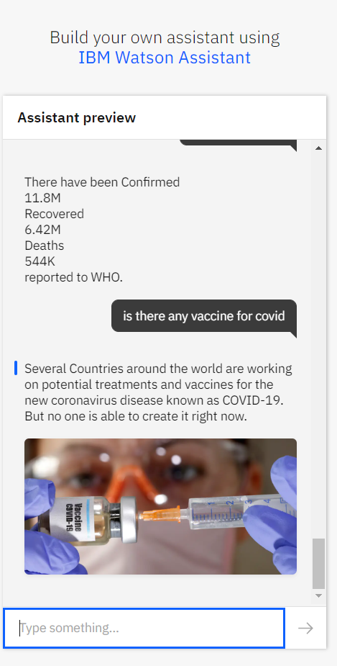
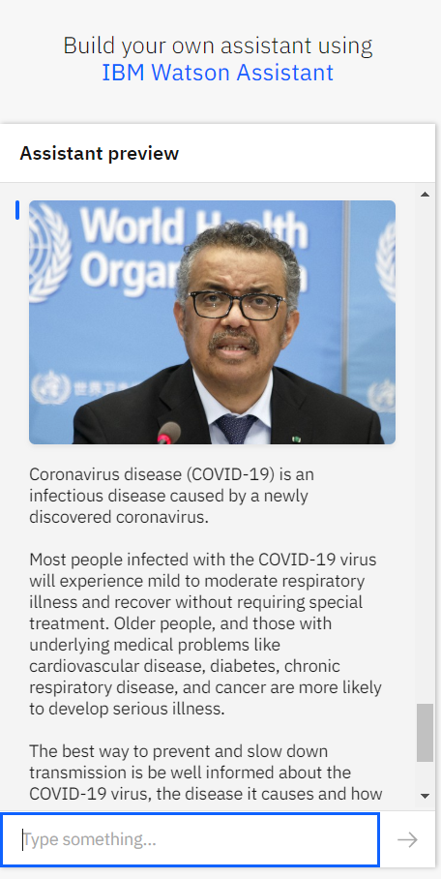

Slide 8
As life has changed during the pandemic, many people are getting worried about COVID-19 and the new normal life. Call centers and hospitals have been receiving so many queries related to the lockdown, symptoms of the virus, transportation, work, etc.. which kept call centers busy with common questions.
How the Assistant Works?
The three main components of Watson Assistant are Intents, Entities, and Dialog. Intents are sets of user examples to train Watson Assistant. They represent the questions that a user might ask. Entities are dictionaries of keywords and patterns, and the Dialog is the flow of the conversation, where we can build nodes and link them to our intents and entities to design and handle the conversation. Each assistant has its intents and entities, and we trained the assistant using common words among different dialects to make it understand questions.

Slide 9
SOURCE CODE
https://web-chat.global.assistant.watson.cloud.ibm.com/preview.html?region=eu-gb&integrationID=b3c5d2e9-7ffe-44a7-878d-e6603e4b8a13&serviceInstanceID=d28cc84f-1c3c-4d79-818d-a6b722c461f2

